Slide 1

Project Title - Seasonal Agriculture Performance Analysis
Name - P Durgashyamanth
College Name - BMS College of Engineering, Bangalore
AICTE STU ID : STU6a6594b70202e1785042103

Slide 2

PROBLEM STATEMENT
Agricultural activities are influenced by seasonal variations in environmental conditions, farming practices, resource availability and market conditions. As a result, agricultural performance may differ from one season to another. However, raw agricultural data does not clearly explain how agricultural performance changes across seasons or what patterns can be observed in different seasonal conditions. The problem is to analyze the given agricultural dataset and investigate seasonal differences in agricultural performance by identifying meaningful patterns, trends, relationships and variations within the available data.

Slide 3
Project Description
This project performs Exploratory Data Analysis (EDA) and Statistical Analysis on agricultural farm data containing 4,000 farm records across 8 states, 8 crops, and 3 seasons.
The analysis covers:
Data cleaning and validation
Missing-value and duplicate analysis
Crop, state, and season-wise performance
Yield, revenue, cost, and profit analysis
Water usage and water-efficiency analysis
Disease and pest risk analysis
Crop × Season and State × Season comparisons
Correlation analysis
One-way and two-way ANOVA
Identification of high-performing and low-performing combinations

Slide 4

WHO ARE THE END USERS?
👨‍🌾 Farmers
Select suitable crops and seasons
Compare expected profitability
Improve water utilization
Support farm-level decision making
🏢 Agricultural Departments & Government Agencies
Identify regional and seasonal agricultural patterns
Support agricultural policies and planning
Identify areas requiring resource or productivity improvements
🌱 Agronomists & Agricultural Researchers
Study relationships between environmental conditions and crop performance
Analyze crop-season behavior
Conduct further agricultural research
💼 Agribusiness & Agricultural Consultants
Identify potentially profitable crop combinations
Support farm investment and planning decisions

Slide 5

Technology Used
Technology Purpose
Python Data analysis and processing
Pandas Data cleaning, manipulation and aggregation
NumPy Numerical computations
Matplotlib Data visualization
Seaborn Statistical visualizations and heatmaps
SciPy Statistical tests
Statsmodels ANOVA and Tukey HSD analysis
Jupyter Notebook Development and analysis environment

Slide 6
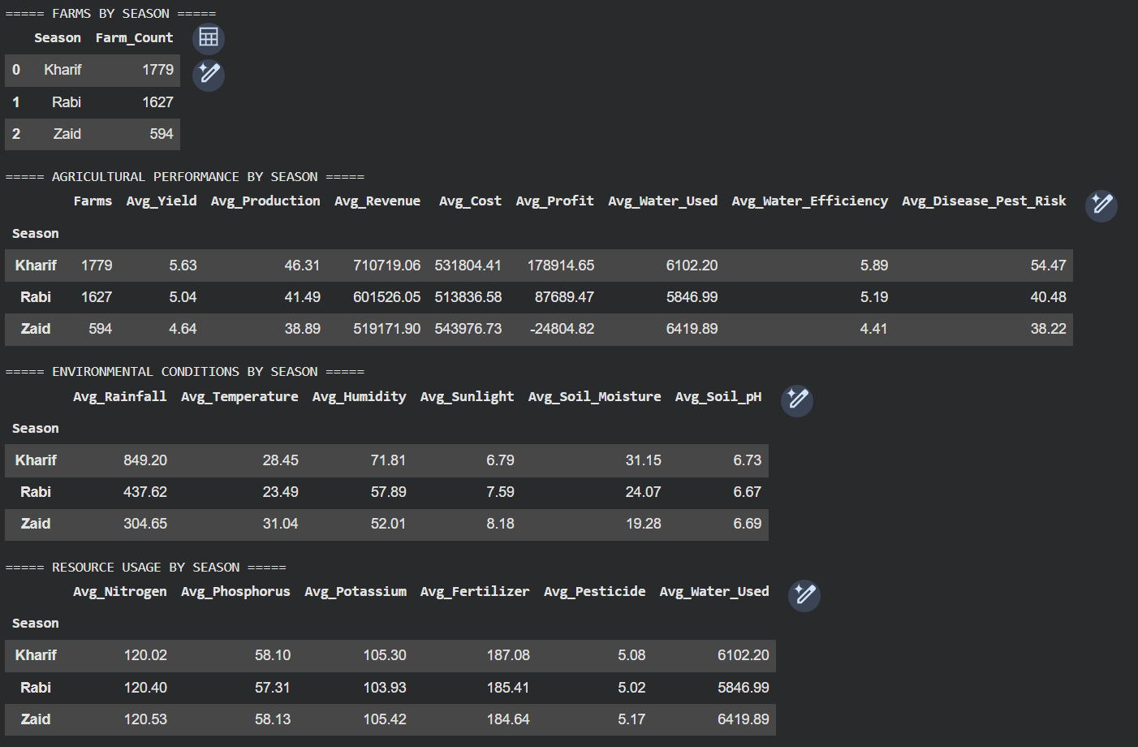
RESULTS
[Add screen shots of your code ]

Slide 7
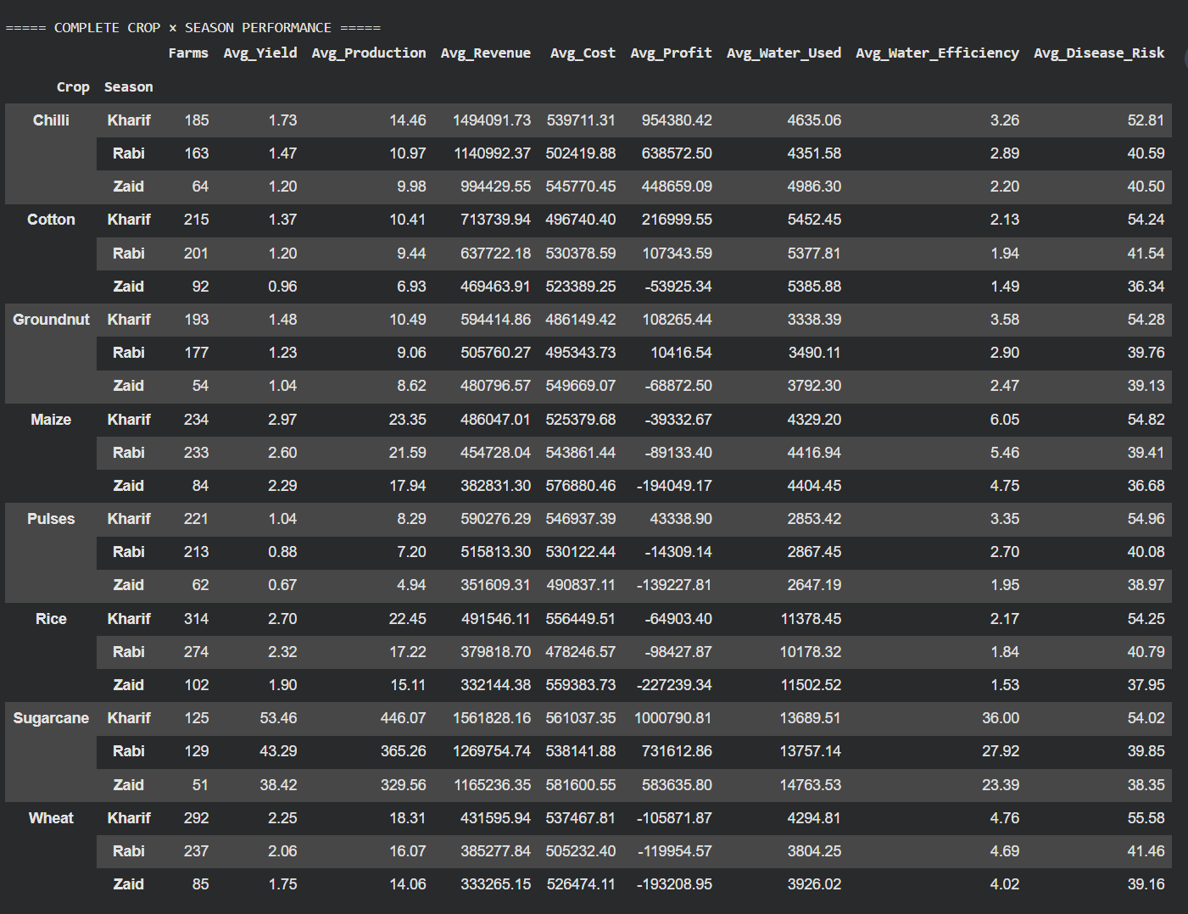
RESULTS
[Add screen shots of your code ]

Slide 8
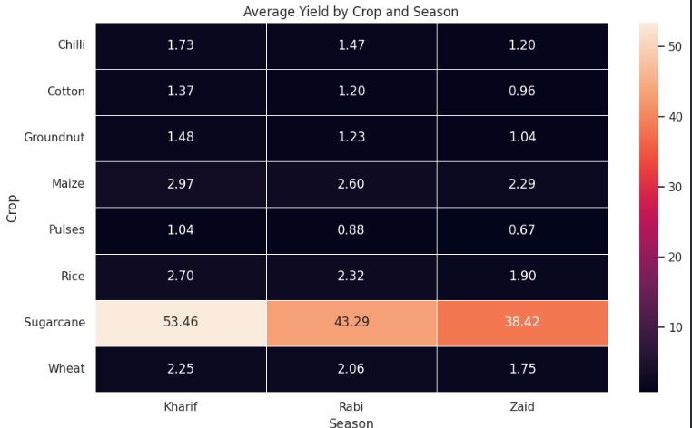
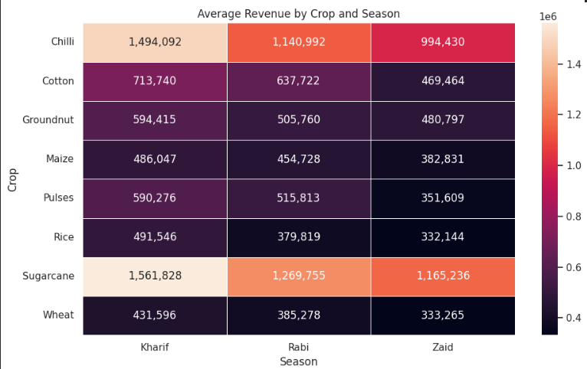
RESULTS
[Add screen shots of your code ]

Slide 9
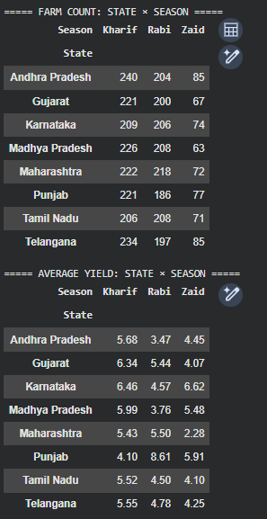
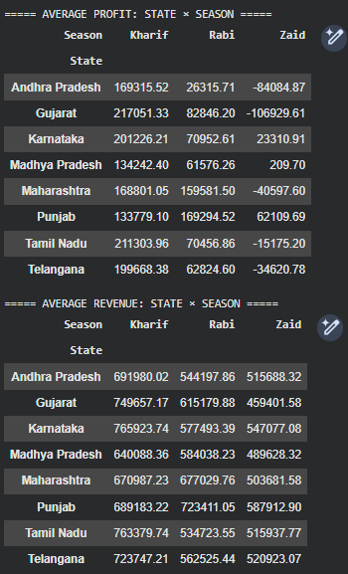
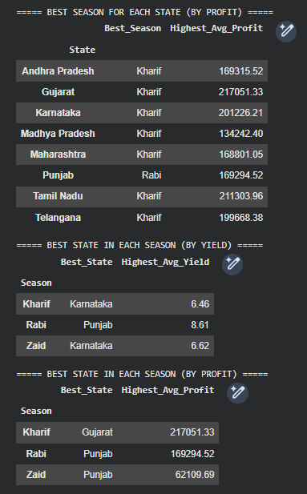
RESULTS
[Add screen shots of yo

Slide 10
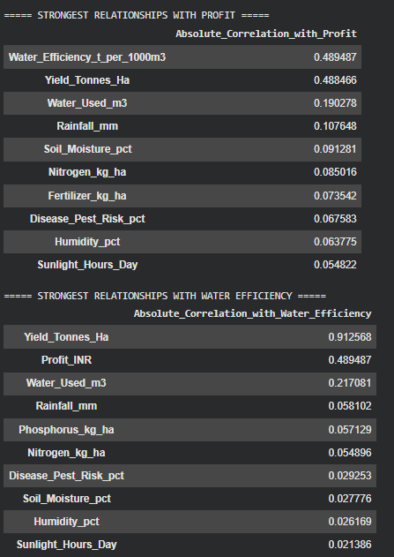
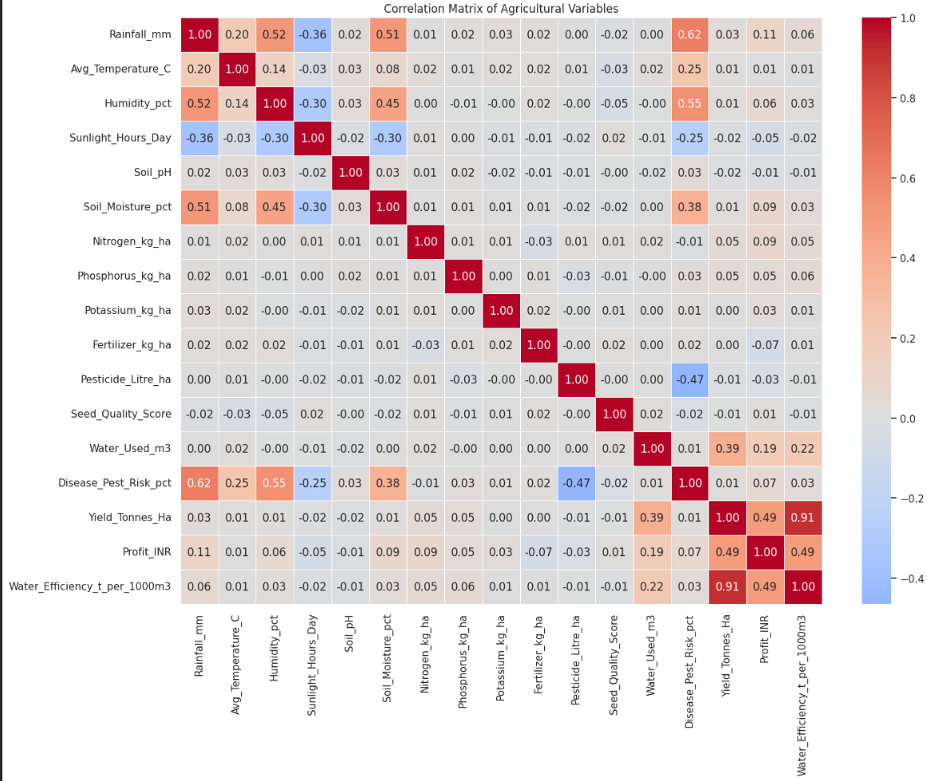
RESULTS
[Add screen shots of your code ]

Slide 11
Future scope
🔮 Predictive Modeling
Develop machine-learning models to predict:
Crop yield
Farm profit
Water requirements
Disease/pest risk
💧 Smart Water Management
Use historical and environmental data to recommend optimal irrigation levels and improve water efficiency.
🌾 Crop Recommendation System
Build a recommendation system that suggests the most suitable crop and season based on:
State/location
Soil conditions
Weather
Available water
Expected profitability
📊 Interactive Dashboard
Develop a dashboard using tools such as Power BI, Tableau, or Streamlit where users can interactively explore crop, state, and season performance.

Slide 12
GitHub Link
https://github.com/Shyamanth-001/Seasonal-Agriculture-Performance-Analysis

Slide 13
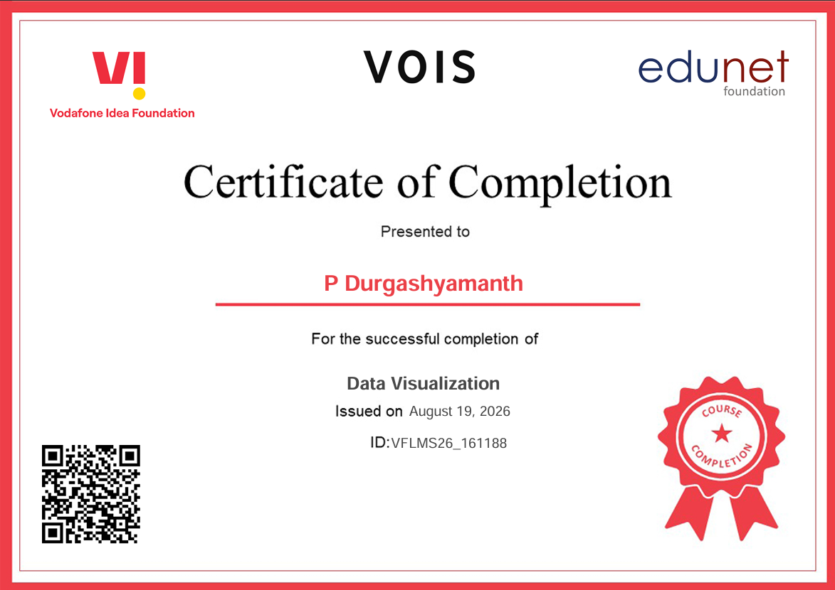
VOIS Course completion certificate Course name- Data Visualization

Slide 14
Thank you
.
.

